Slide 1
BMD ENG 301 Quantitative Systems Physiology (Nervous System)
Spinal Reflex Circuits (cont’d)
Professor Malcolm MacIver

Slide 2
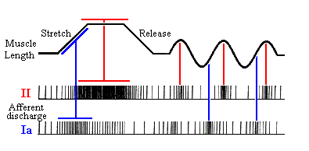
Proprioceptor Activity
Functions

Slide 3
Types of Neurons
Type | Axon Diameter (μm) | Signal Speed (ms⁻¹) | Soma Location | Innervate
Ia sensory | 13-20 | 70-120 | Dorsal root ganglion | Nuclear bag fibers | Very fast
II sensory | 6-12 | 30-70 | Dorsal root ganglion | Nuclear bag and nuclear chain fibers | Fast, second most highly myelinated axon type
γ motor | 5-8 | 4-24 | Ventral horn | Intrafusal fibers | Small and slower conduction
α motor | 13-20 | 80-120 | Ventral horn | Muscle fibers | Very fast

Slide 4
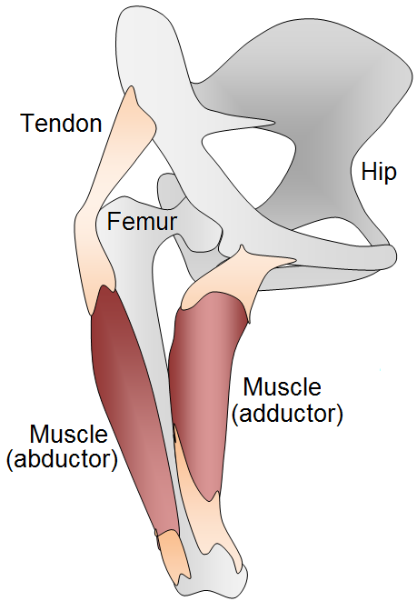
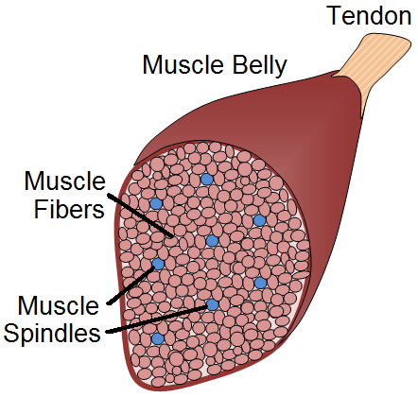
Placement of Spindles
Found in almost all muscles
From 10 to over a 1000 spindles in each muscle
Number of spindles roughly proportional to size of muscle
Do not run the length of the muscle
except for short muscles

Slide 5
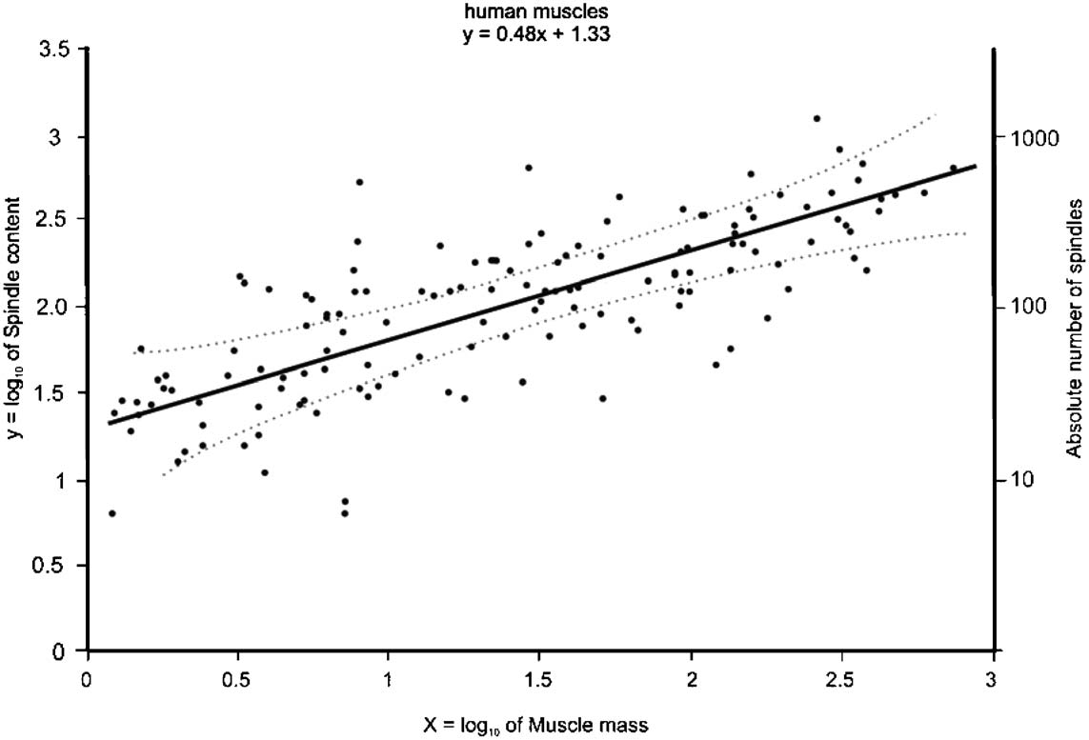
Number of Spindles

Slide 6
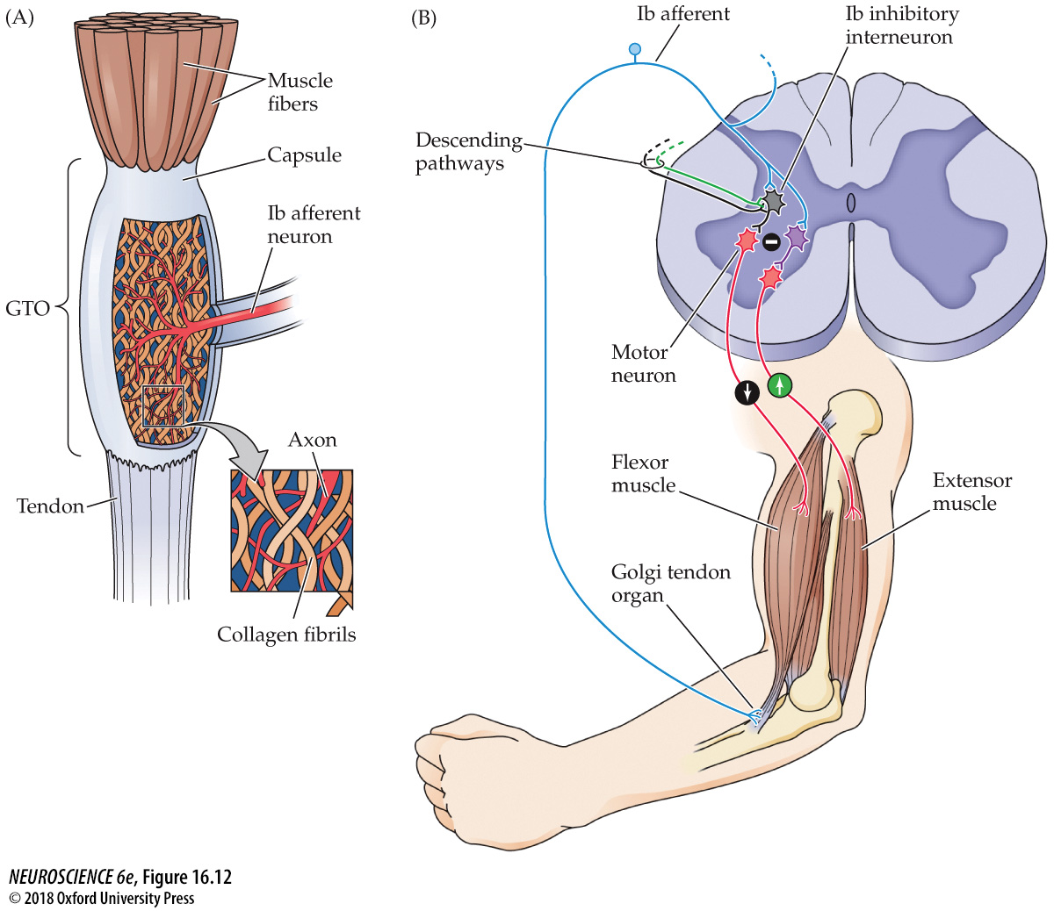
Negative feedback regulation of muscle tension by Golgi tendon organs

Slide 7
Ib afferent encodes force
Muscle Force
Ib afferent firing

Slide 8
Ib afferent encodes force
Ib afferent firing rate
Muscle force

Slide 9
Spindles and GTOs
Spindle Sensor | GTO Sensor
Length and △L/dt | Force
Ia and II afferents | Ib afferent
Ia afferent provides direct excitatory drive to alpha motor neurons innervating homonymous and synergist muscles | Ib afferent provides inhibitory drive to alpha motor neurons innervating homonymous muscle through interneurons
Ia afferent provides inhibitory drive to alpha motor neurons innervating antagonist muscle through interneurons | Ib afferent provides excitatory drive to alpha motor neurons innervating antagonist muscle through interneurons
 | Ib afferent has widespread connections in the spinal cord
Spindle arranged in parallel with the extrafusal fibers | GTO arranged in series with the extrafusal fibers

Slide 10
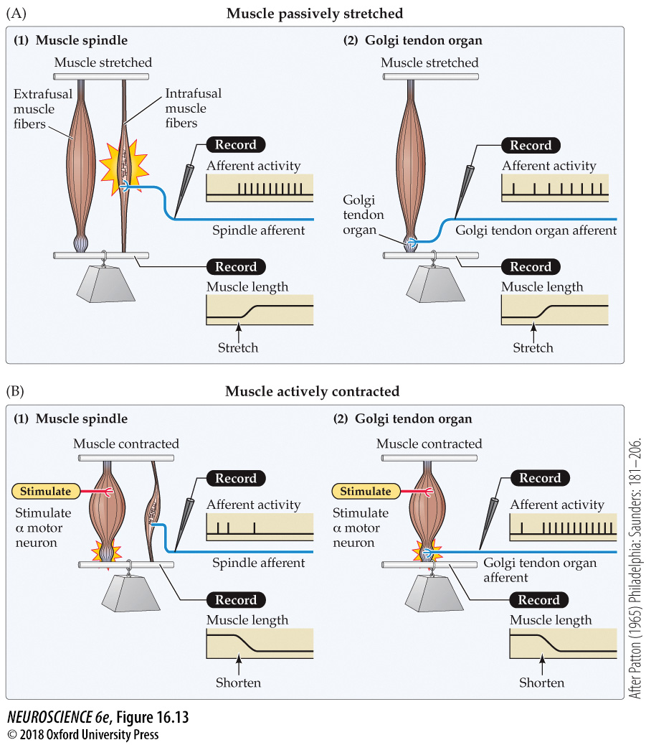

Slide 11
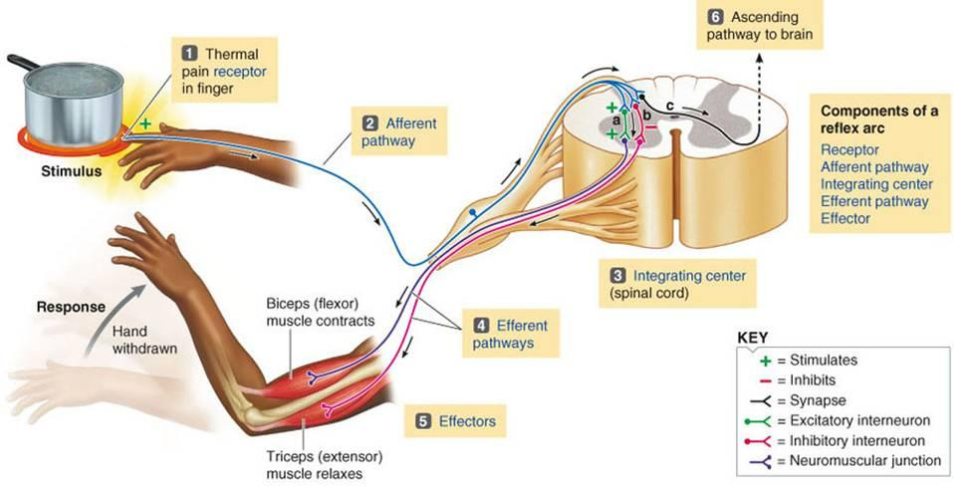
Flexor Reflex

Slide 12
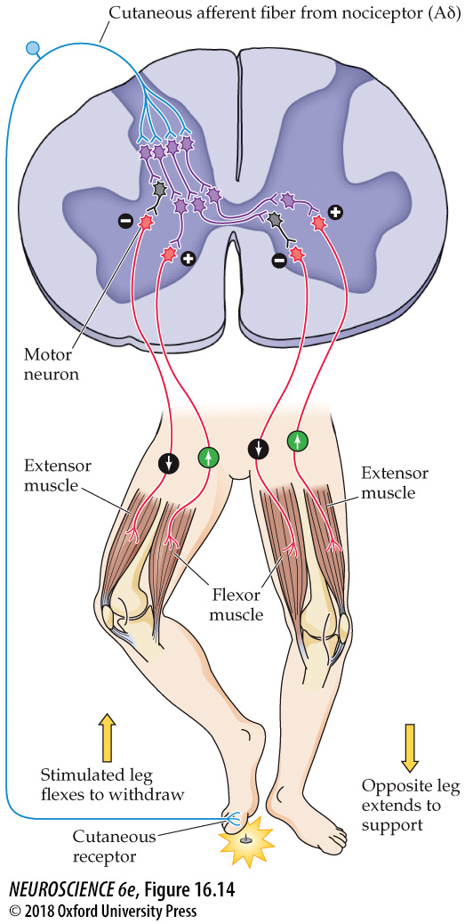
Spinal cord circuitry for the flexion–crossed extension reflex

Slide 13
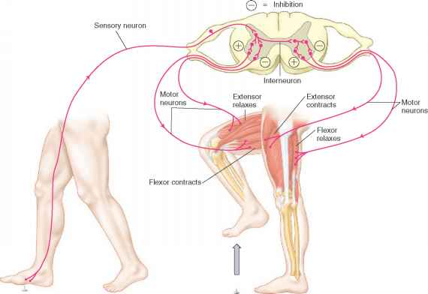
Withdrawal + Crossed Extension Reflexes

Slide 14
Reflexes
Reflex | Afferent | Detects | Mode of Action | Function
Stretch (Myotatic) | Ia from spindle (70-120 ms⁻¹) | Phasic stretch of muscle | Contraction of homonymous muscle, relaxation of antagonist muscle | Adjust a motor action for unpredicted perturbation
“Inverse” Myotatic | Ib from GTO (70-120 ms⁻¹) | Active stretch of tendon | Contraction of antagonist muscle, relaxation of homonymous muscle (BUT not really the exact opposite of the myotatic action) | Control of muscle force/stiffness (prevent overstretch)
Group II | II from spindle (30-70 ms⁻¹) | Steady stretch of muscle | Complex | Posture
Flexor | II, III, IV from cutaneous nerve endings (0.5-70 ms⁻¹) | Harmful stimulus | Ipsilateral flexion and contralateral extension | Withdraw limb from harm

Slide 15
Doc cam

Slide 16
BMD ENG 301 Quantitative Systems Physiology (Nervous System)
Locomotion
Professor Malcolm MacIver

Slide 17
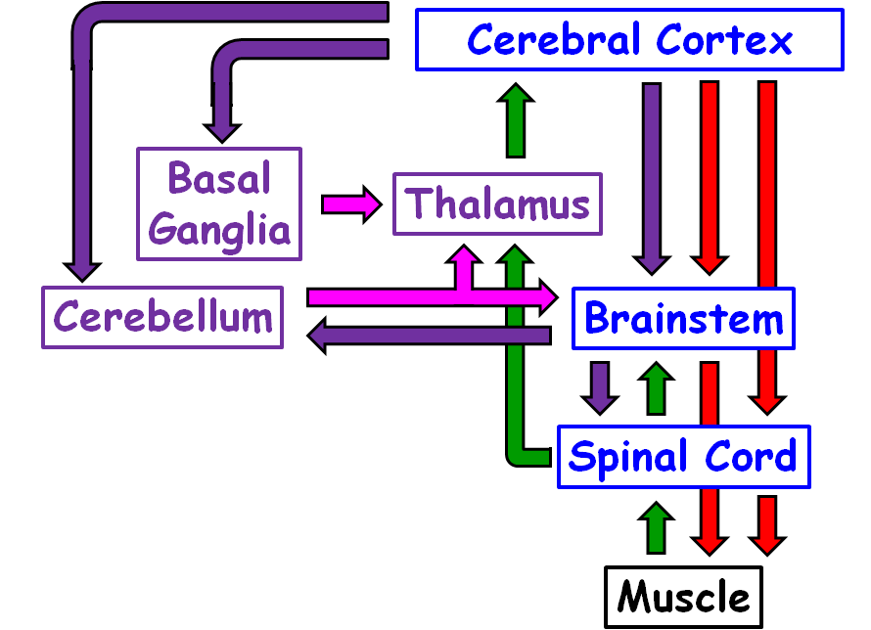
Organization of the motor system (body only)

Slide 18
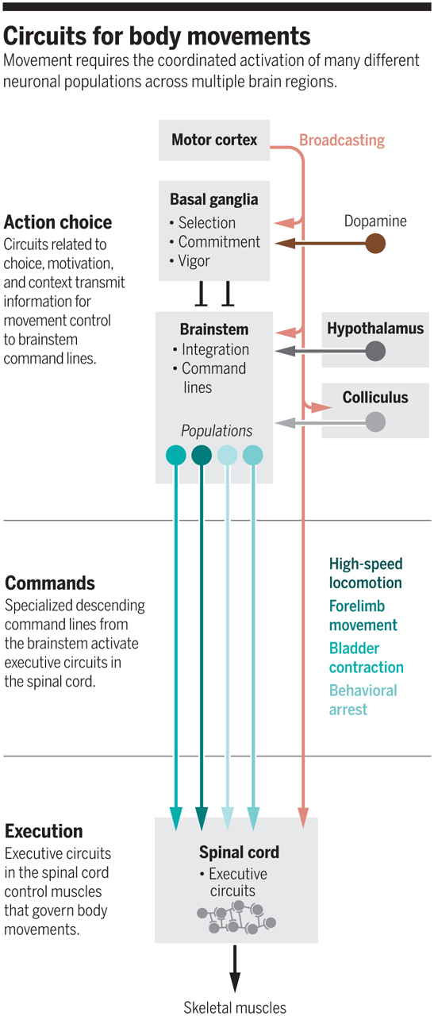
Motor control is distributed

Slide 19
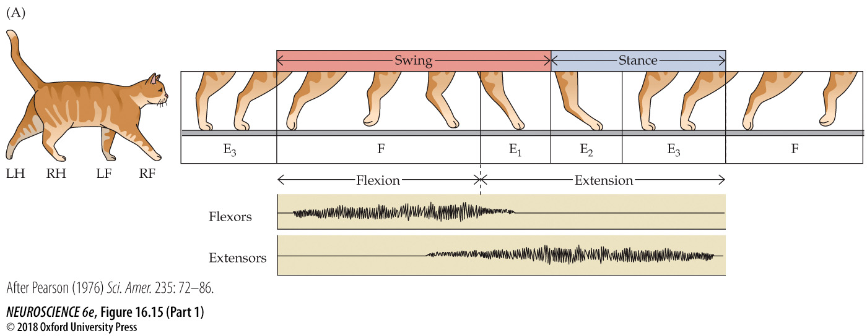
The mammalian cycle of locomotion is organized by central pattern generators in the spinal cord

Slide 20
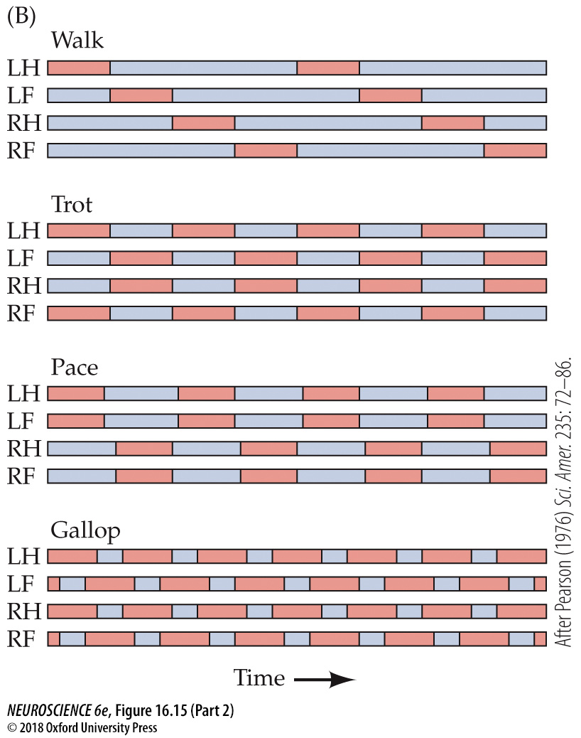
The mammalian cycle of locomotion is organized by central pattern generators in the spinal cord

Slide 21
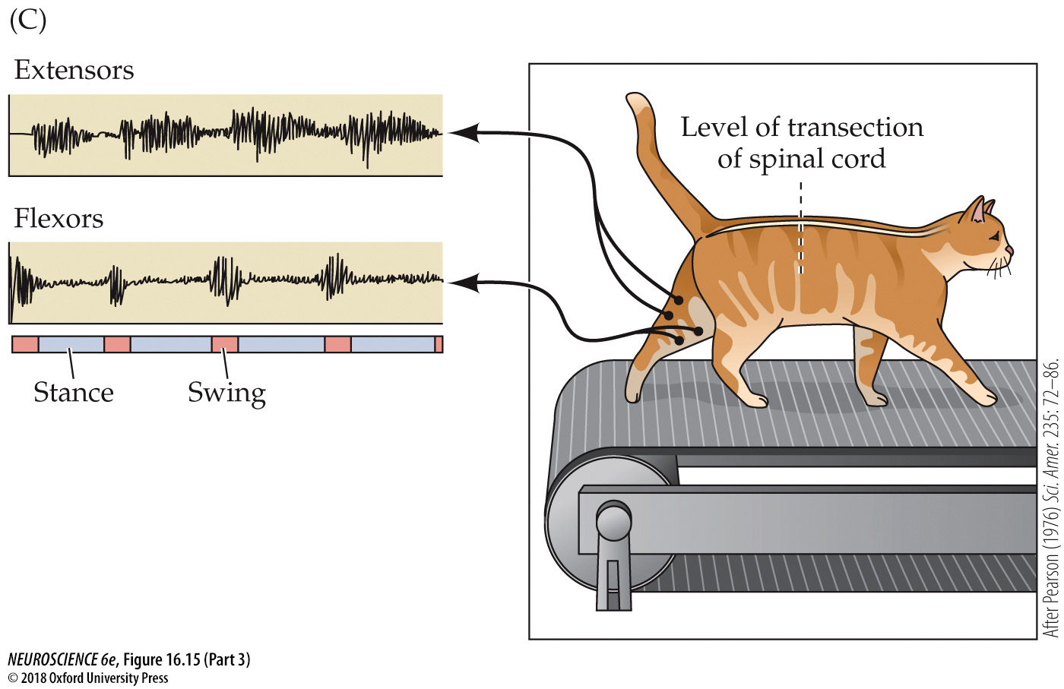
The mammalian cycle of locomotion is organized by central pattern generators in the spinal cord

Slide 22
Doc cam

Slide 23
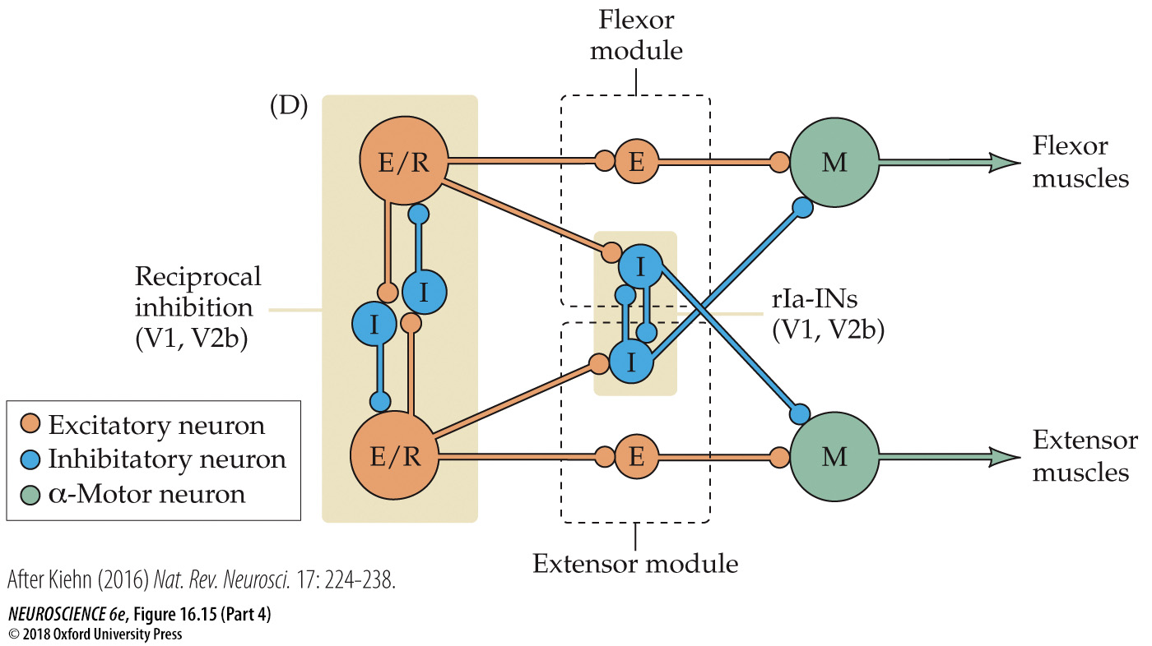
Central pattern generator in the spinal cord

Slide 24
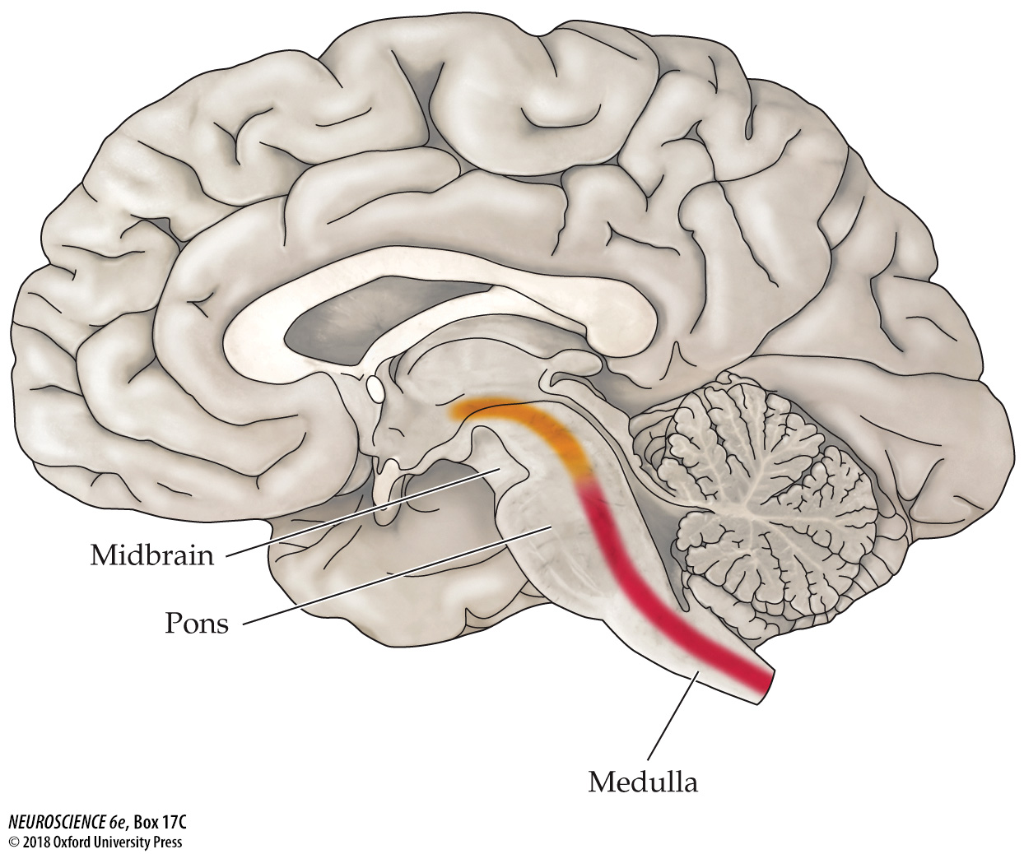
The reticular formation

Slide 25
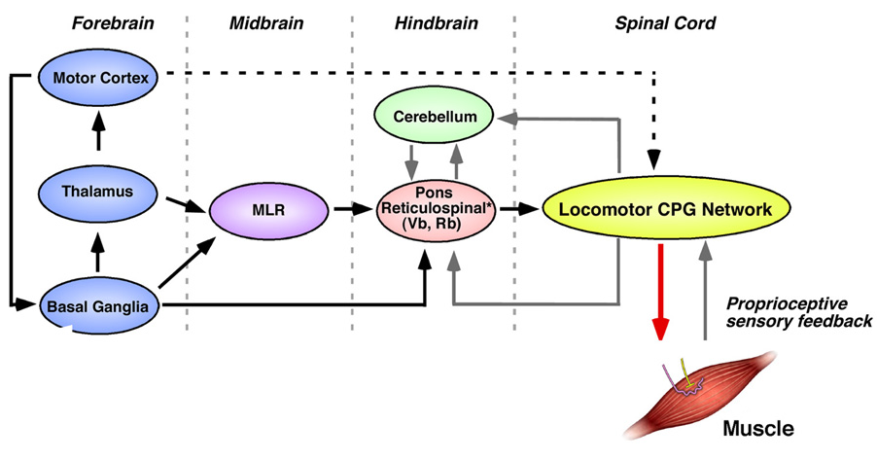
The Interacting Parts
MLR = Mesencephalic locomotor region

Slide 26
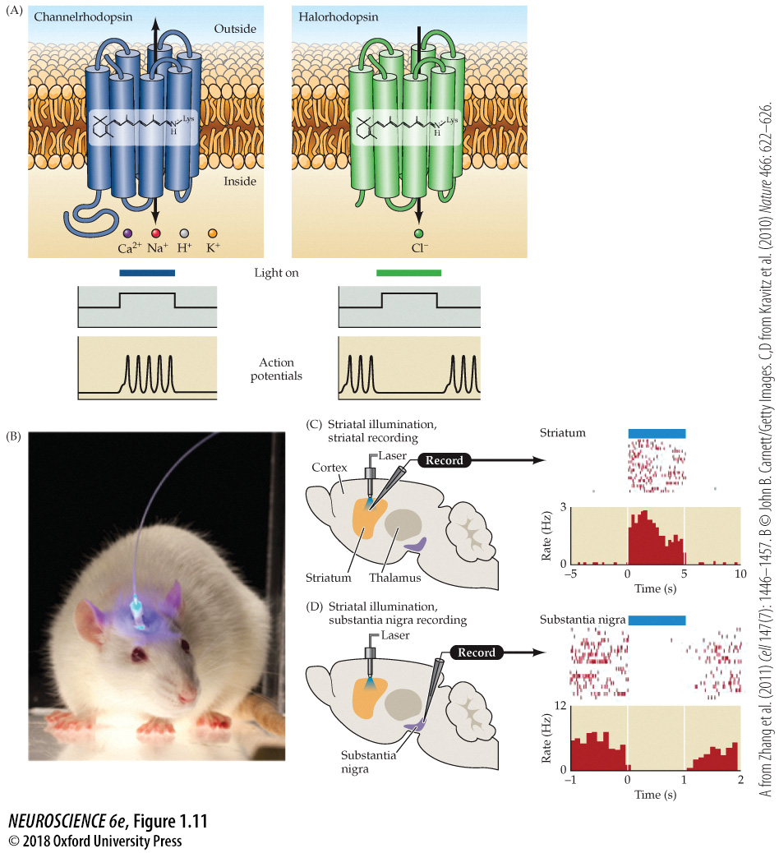
Optogenetic methods used to control electrical activity in nerve cells
Notes:
Figure 1.11 Optogenetic methods used to control electrical activity in nerve cells. (A) Two bacterial opsins, showing their 7-transmembrane domains. The light-sensing all-trans retinal transduces a change in illumination to transiently open the channels. (B) A fiber-optic probe, stabilized with a permanent head mount, can use a laser to deliver a narrow bandwidth of light to specific opsin-expressing neurons. (C) Illumination of bacterial opsins expressed in striatal neurons that regulate movement. Neurons expressing channelrhodopsin in the striatum, where neurons have little or no spontaneous action potential activity (regions on the graph with very few marks), fire robustly when illuminated (the histogram indicates action potential frequency when light is on and channelrhodopsin is activated). (D) Neurons in the substantia nigra pars reticulata, where neurons have a high frequency of spontaneous action potential activity (rasters and histograms in the left- and right-flanking regions), can be “silenced” transiently by illumination in the striatum. The striatal axons release the inhibitory neurotransmitter GABA. Thus, when the striatal neurons are stimulated optogenetically, the result of the “activation” is increased inhibition in the substantia nigra. Thus, optogenetic mechanisms can assess the physiology of neural circuits based on the activation of neuronal populations. (A after Zhang et al., 2011; C,D after Kravitz et al., 2010.)

Slide 27
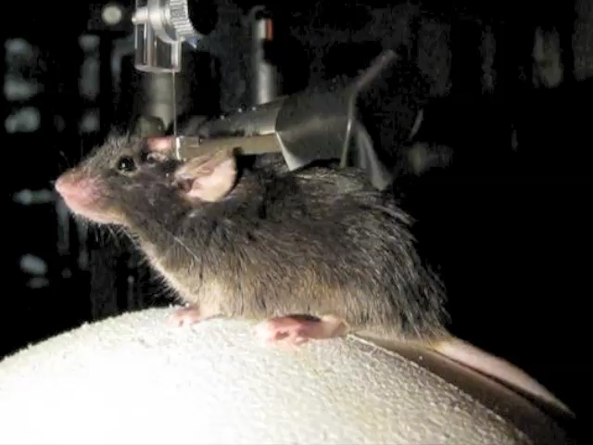
Courtesy Cris Neil, U. Oregon

